Slide 1
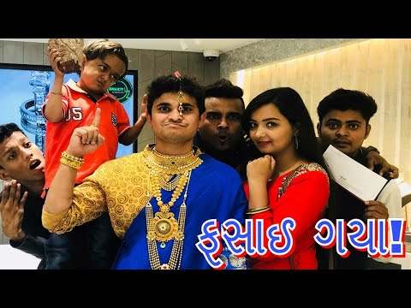
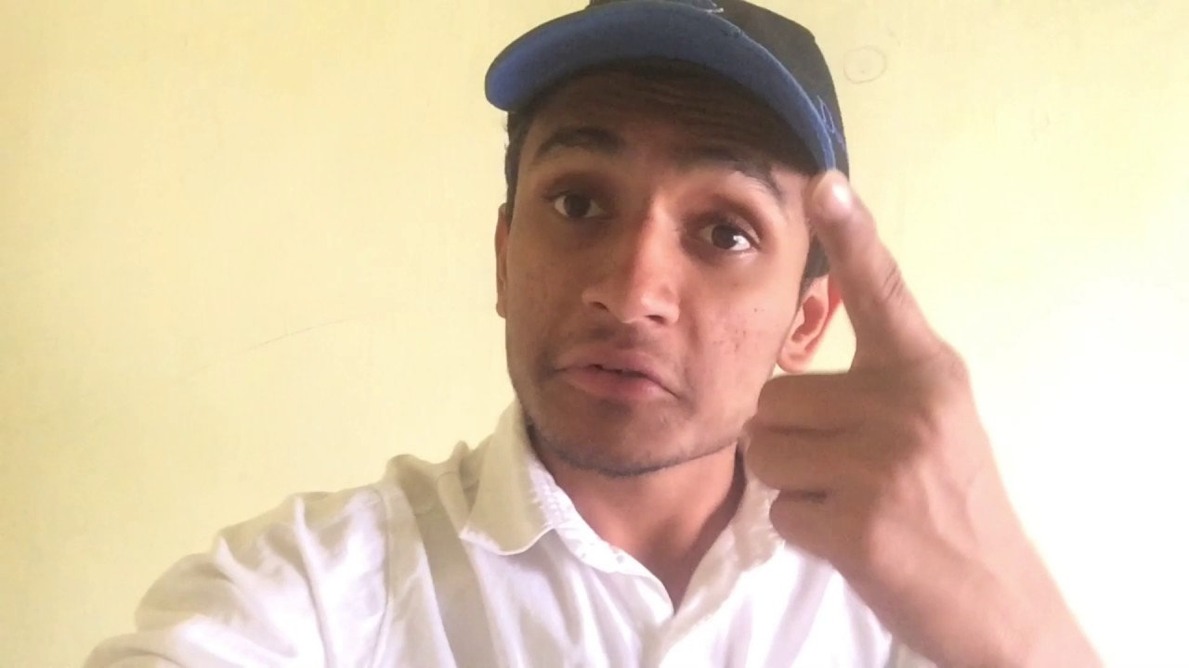
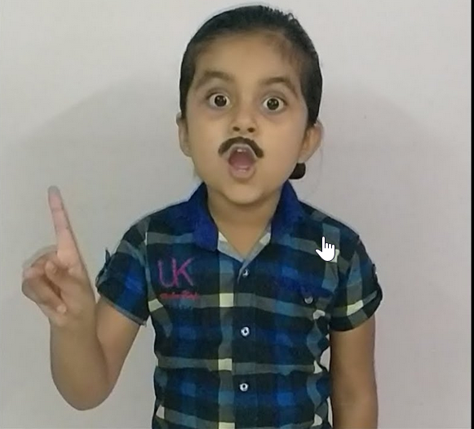
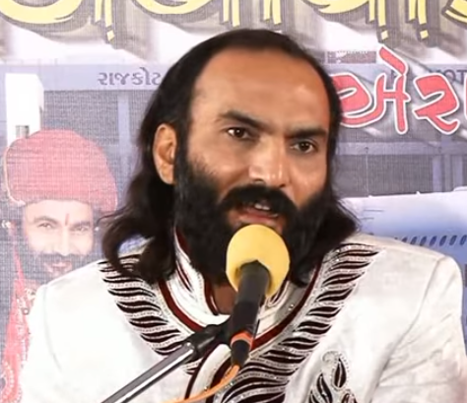

Slide 2

ગુજરાતી HD વિડિઓ
2018

Slide 3

ગુજરાતી HD વિડિઓ
2018

Slide 4

Kinjal Dave Video Songs

Slide 5
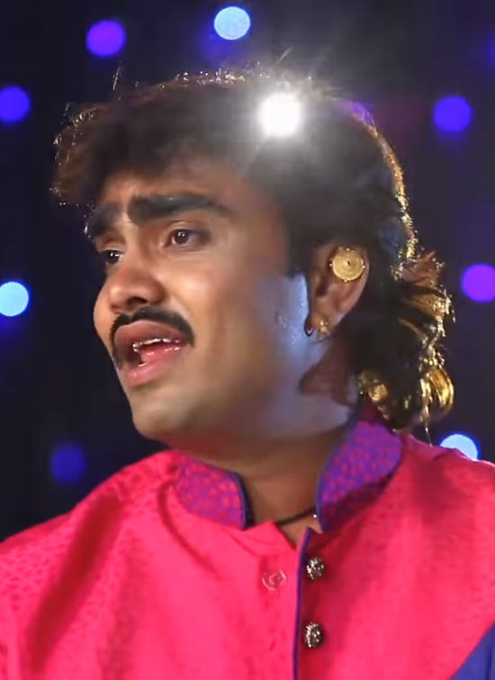
Jignesh Kaviraj Video Songs

Slide 6
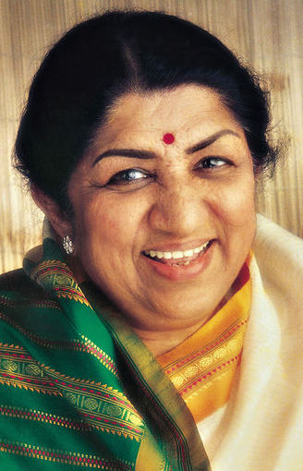
Lata Mangeshkar Old Songs

Slide 7
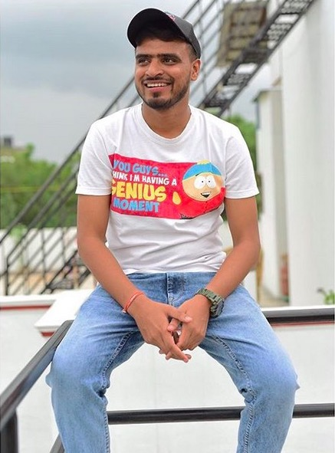

Slide 8
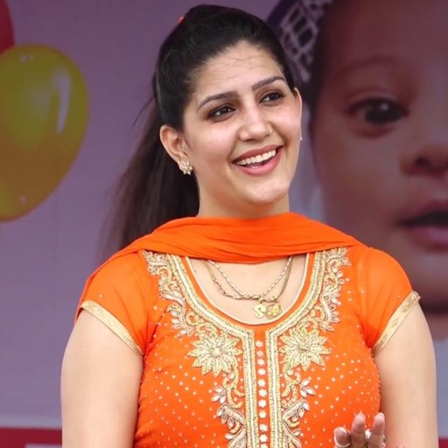

Slide 9


Slide 10


Slide 11

Luccas Neto

Slide 12

Sagar Patel Video Songs

Slide 13

HD VIDEO SONGS 2018
કિંજલ દવે

Slide 14
HD Video
સાગર પટેલ

Slide 16

સાગર પટેલ ની મોજ

Slide 17
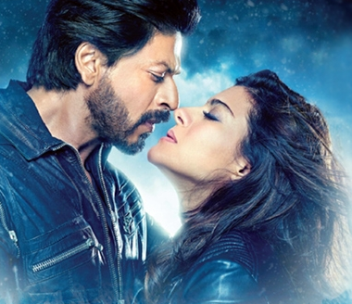
Top Hindi
Songs 2018

Slide 18
Top Hindi
Songs 2018

Slide 19

Top Hindi
Songs 2018

Slide 20
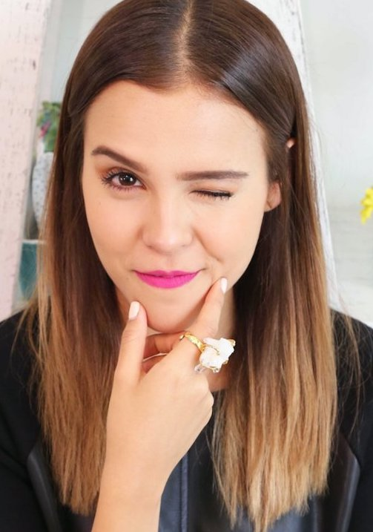
Yuya

Slide 21


Slide 22


Slide 23
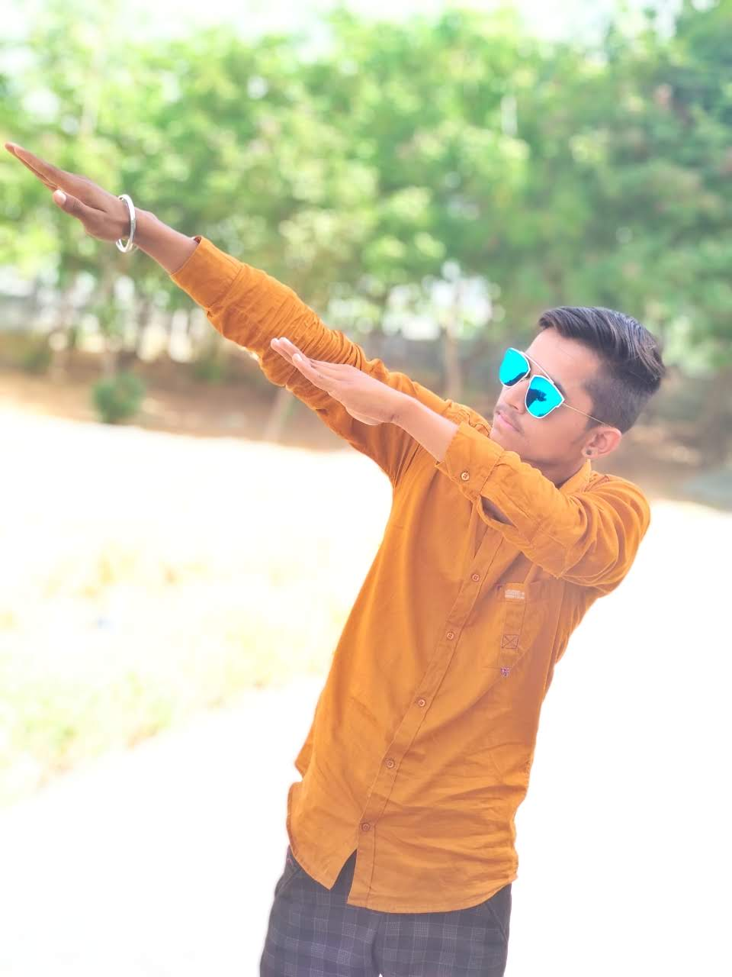
Rutvik Patel – Royal Status

Slide 24
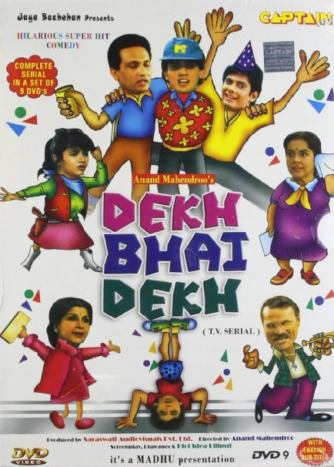

Slide 25

Felipe Neto

Slide 26
Rutvik Patel – Royal Status

Slide 27
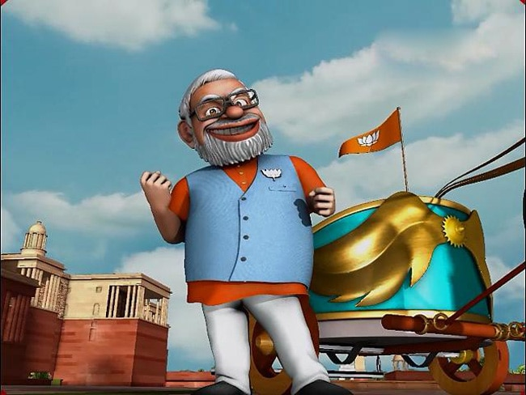
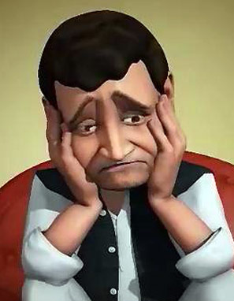
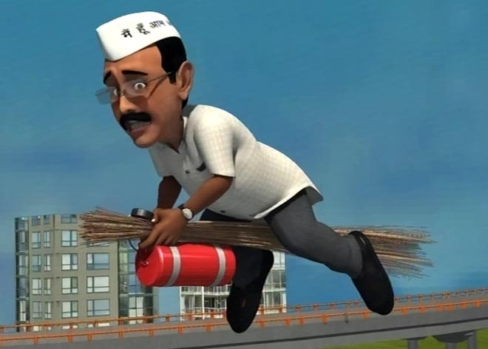
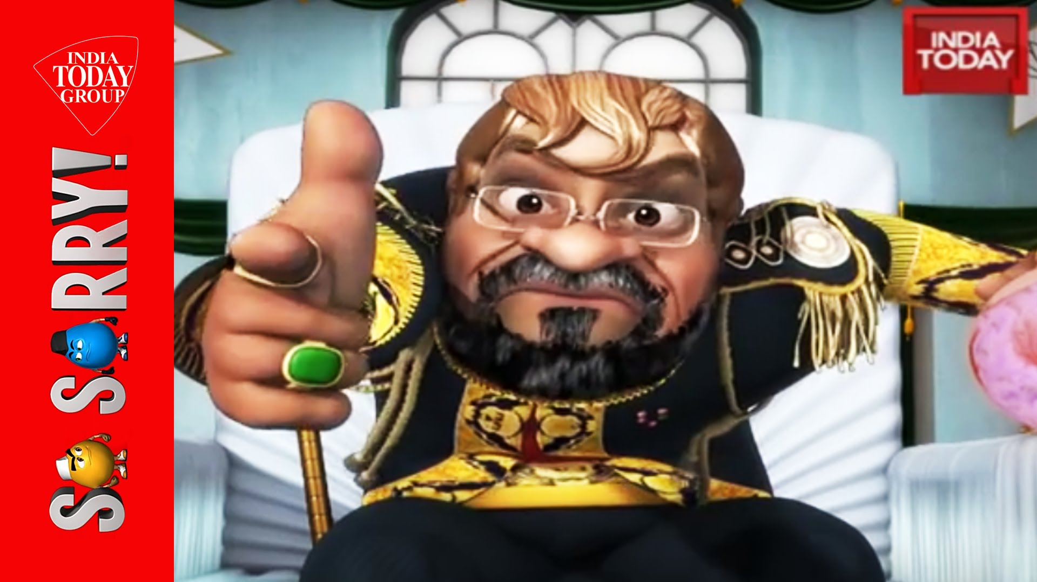
So Sorry

Slide 28

So Sorry Comedy Videos

Slide 29
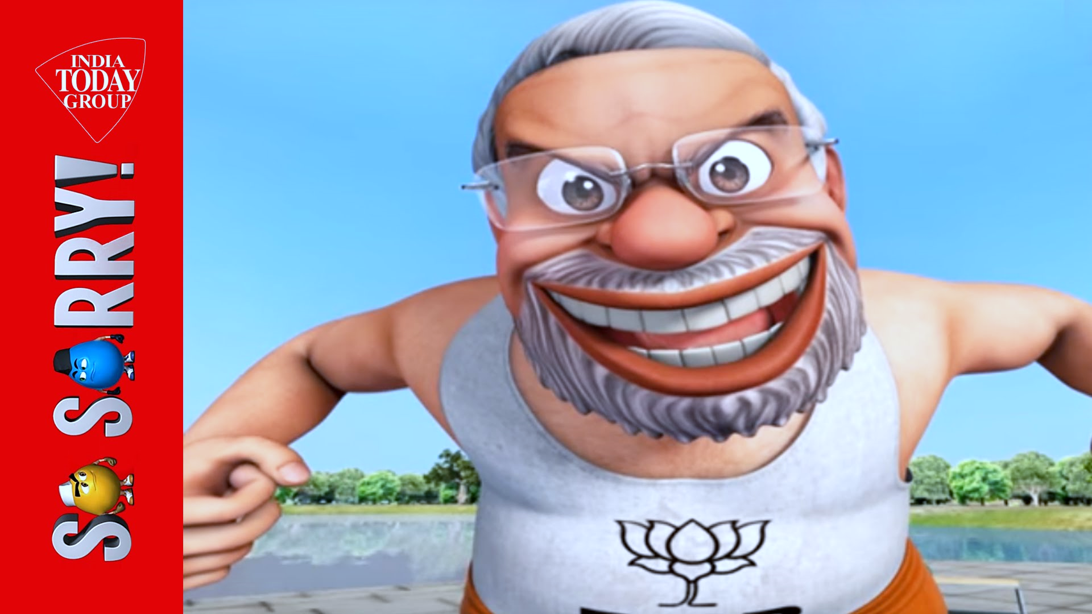


Slide 30
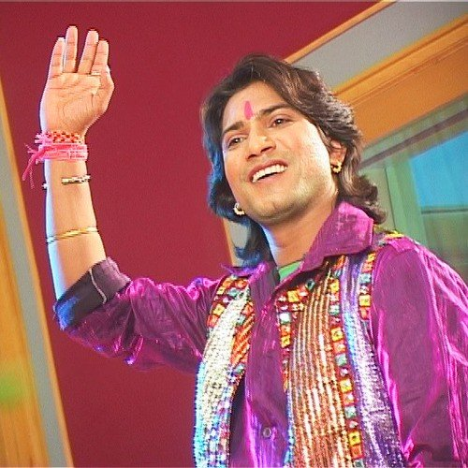
V
T
Vikram Thakor

Slide 31

V
T
Mamta Soni

Slide 33

Haryanvi Comedy Videos

Slide 34
Gujarati HD Videos

Slide 35


Slide 36


Slide 37

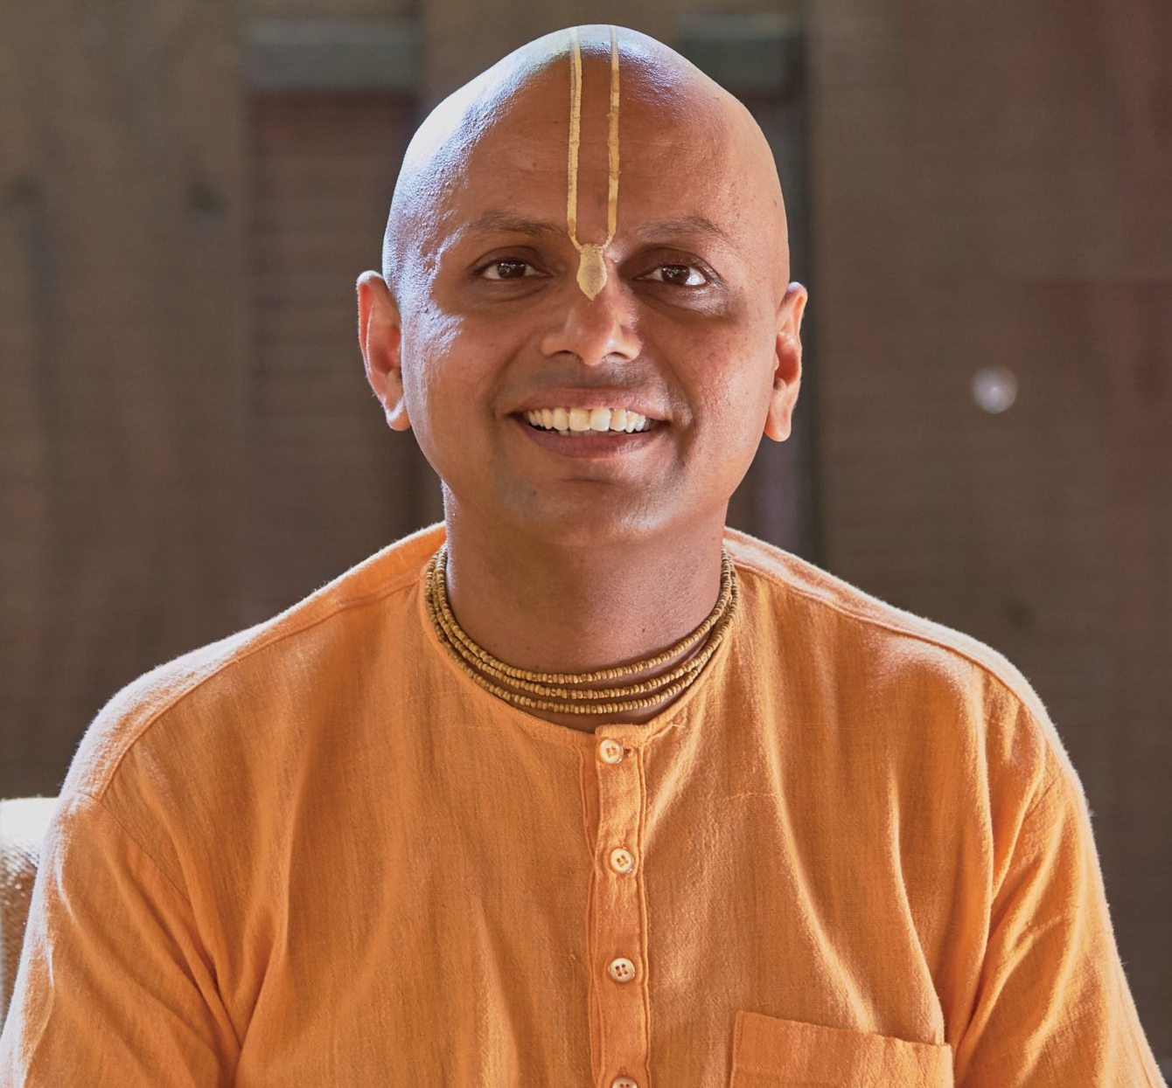

Slide 38


Slide 39


Slide 40

whinderssonnunes

Slide 41


Slide 42
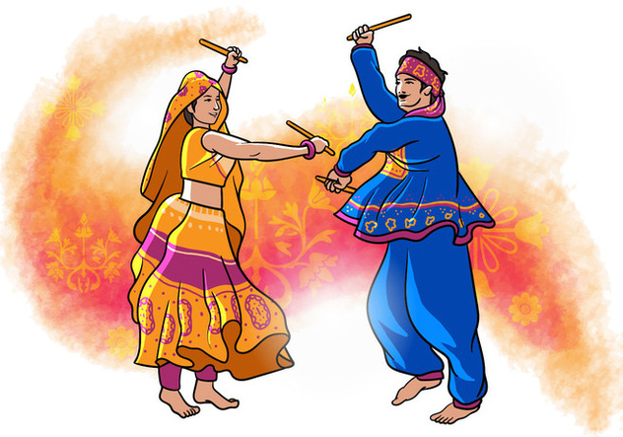
Navratri Garba

Slide 43
Awesome Hindi Videos

